Slide 1


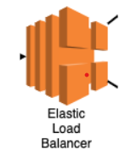



External ALB
Internal ALB
Web server
Firewall
Three –Tier Architecture deployment on AWS

Slide 2
Three –Tier Architecture deployment
Three tier architecture will have a User interface , Application and database.
We can deploy EC2 instance, Roles and Policy as per specification using terraform.

